Slide 1

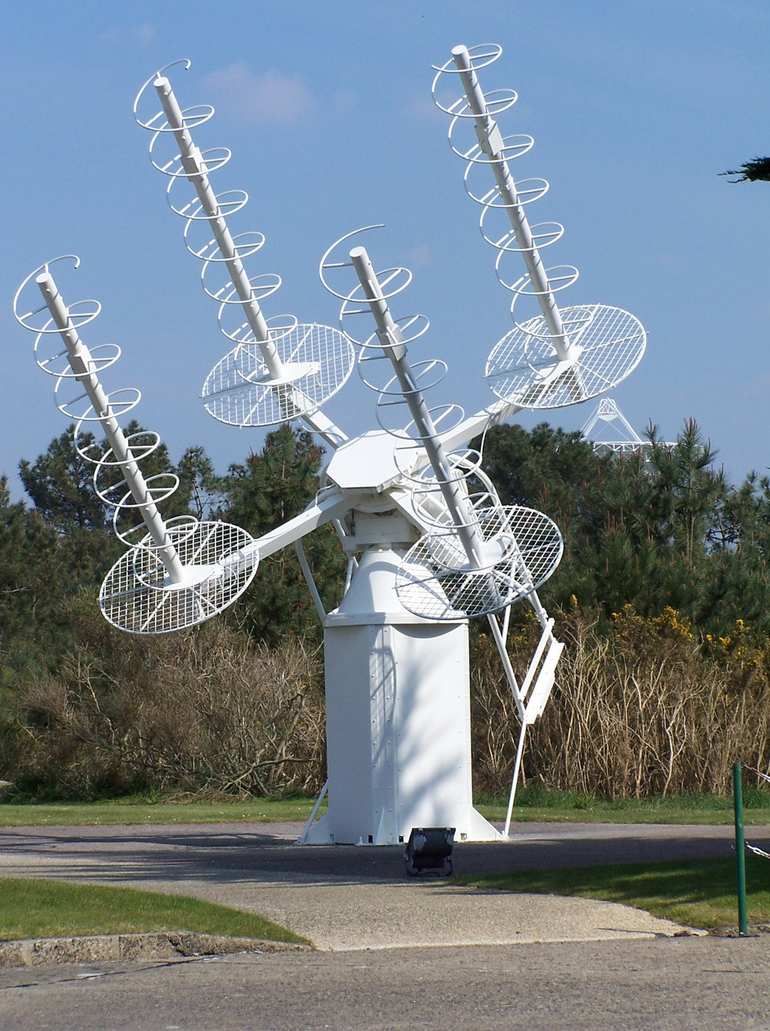


(MINI PROJECT)
Submitted to: Dr. Sukwinder Singh

Slide 2




A helical antenna is a type of radiofrequency (RF) antenna that is characterized by its helix or spiral shape. It is widely used in various
applications, including communication systems, satellite communication, radio astronomy, and radar systems. The helical antenna offers
several advantages, such as broadband
performance, circular polarization, and high gain, making it suitable for both transmitting and receiving signals.

Slide 3








Slide 4





GNU Octave
Utilized for numerical computations, mathematical modeling, and optimization algorithms.
CST (Computer Simulation Technology)
Used for electromagnetic simulation and analysis of the helical antenna.

Slide 5

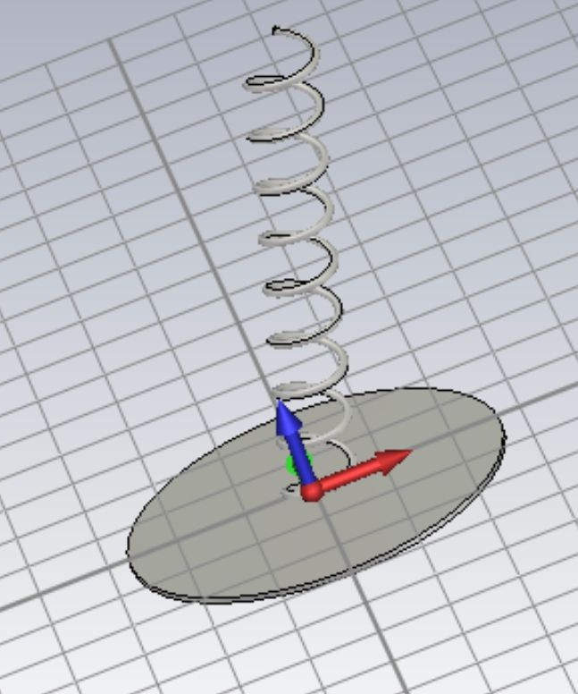
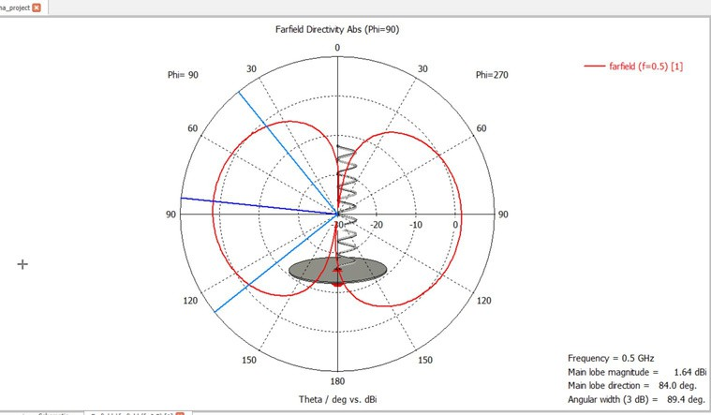
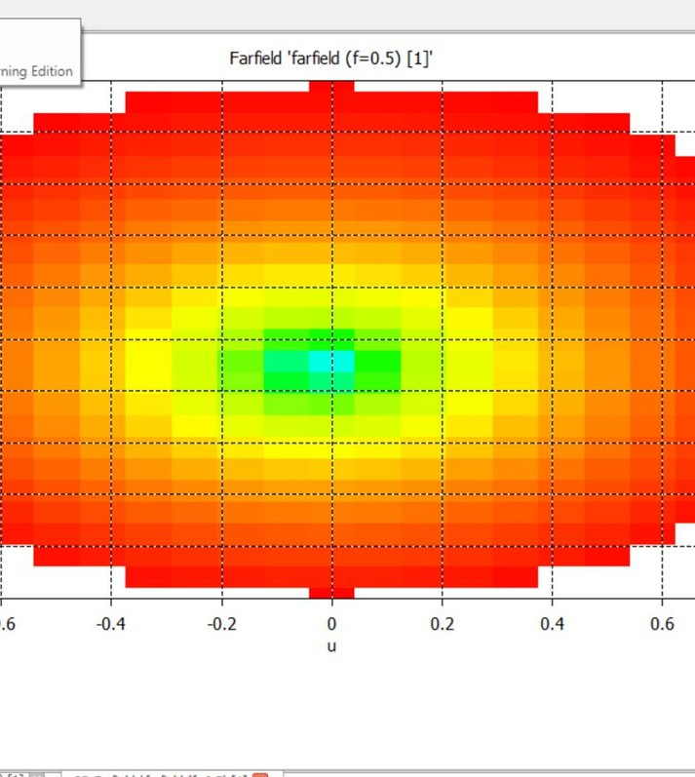

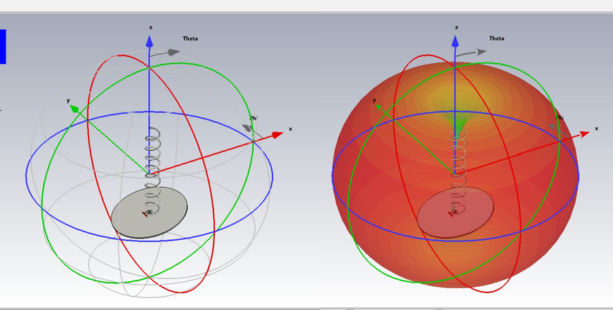
GUI USING CST
Using CST, we tried to provide a basic visualization of the helical antenna. The radiation pattern in 2D and 3D is also shown using this tool. Code Link

Slide 6

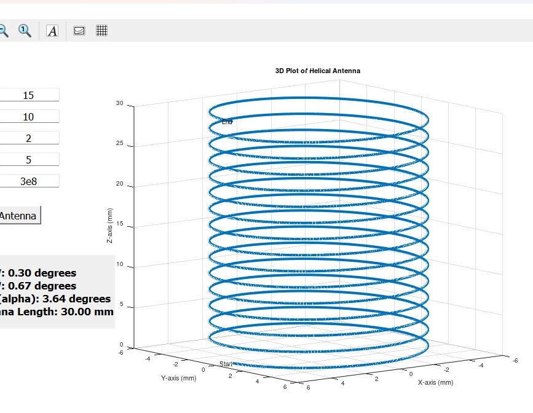
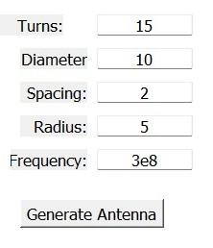
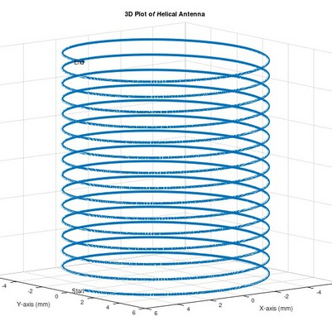

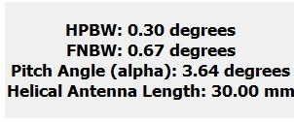
GUI USING GNU OCTAVE
GNU Octave gave us a platform to show the helical antenna model in 2D. The user was given the
freedom to choose their own number of turns, diameter, frequency, and spacing between the turns. The antenna is designed accordingly with the calculation of HPBW, FNBW, Pitch angle, and antenna length. Code Link

Slide 7

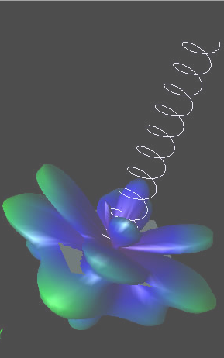




CST was a new software to learn for our team. So it was a challenge to develop the whole project in 3D with such accuracy.
The reduction of elements in CST was a major
problem for us as we had only a student learning tool.
In GNU, we faced some problems in the positioning of different elements in the workspace.

Slide 8
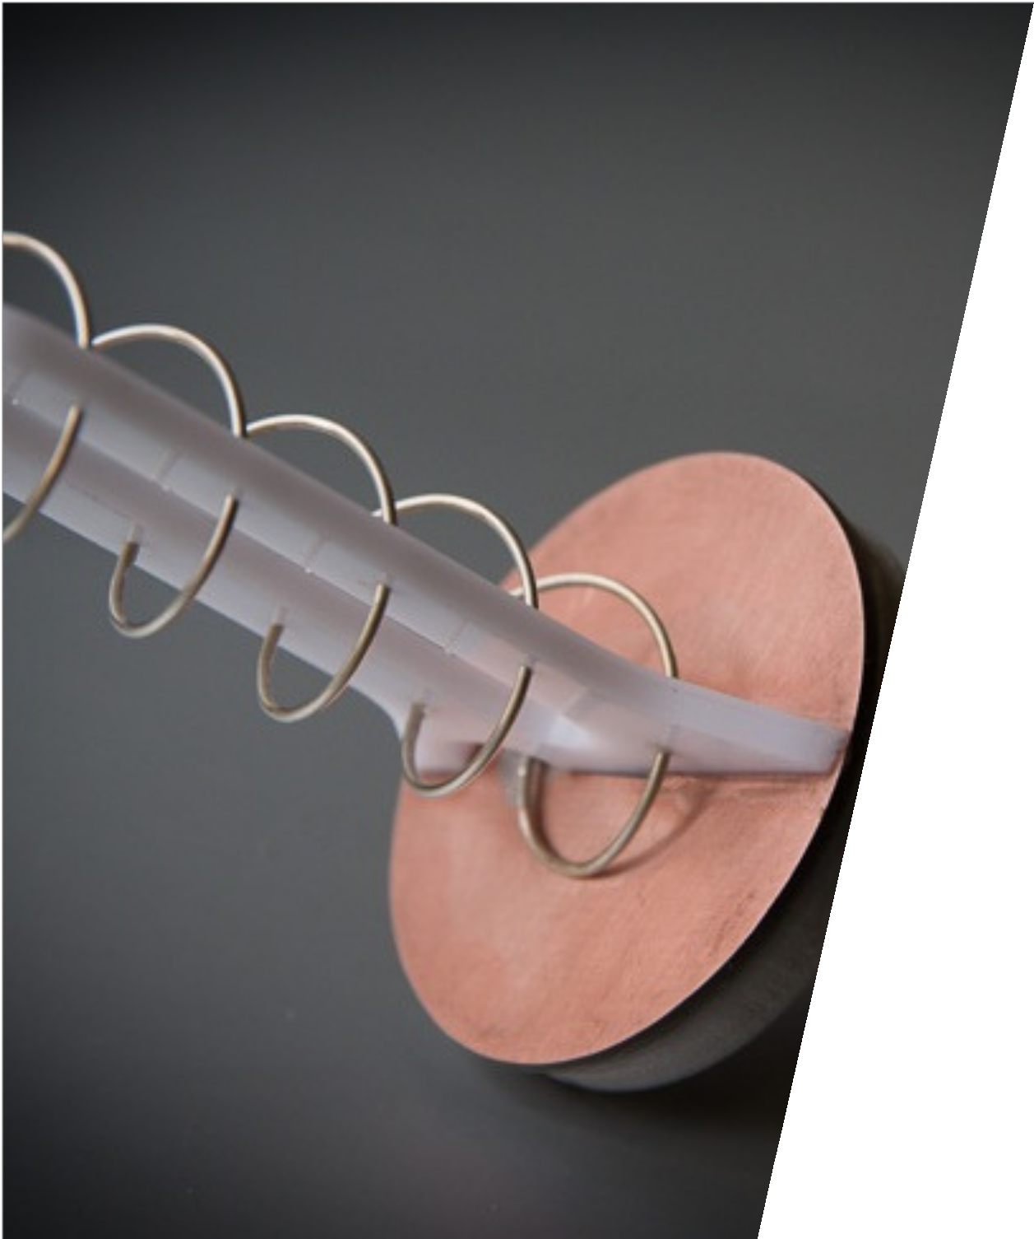

Thank You
Team
Piyush Singh(21104069) Prabhjot Kaur(21104070) Prince Binda(21104073) Prince Ranjan(21104074) Priyal Gangwal(21104075)
Ranjan
Gerente General

